Slide 1

CMake Training Session 2 More Advanced CMake
Jamie Smith

Slide 2
Intro: A Short History of CMake
2000: Kitware contracted to develop a new build system for a bioinformatics program called ITK: a Cross-platform Make
2006: Massive KDE project (Linux desktop environment) switches its entire build system to CMake and gives it rave reviews.
2014: CMake 3.0 is released, introducing many of the features we use as standard today.
More good info: https://www.aosabook.org/en/cmake.html
Notes:
2000: Kitware contracted to develop a new build system for a bioinformatics program called ITK: a Cross-platform Make
Had to be able to read in a buildscript in a single format and generate Makefiles for Linux and Visual Studio project files for Windows
Needed to support complex configurations, 3rd party libraries, and custom commands which generate source files
The CMake of the early 00s was very different from what we know today. It used an almost completely different set of commands, most of which operated at the global scope
2006: Massive KDE project (Linux desktop environment) switches its entire build system to CMake and gives it rave reviews. Many other open-source projects begin to follow suit over the next few years.
2014: CMake 3.0 is released, introducing many of the features we use as standard today.
More good info: https://www.aosabook.org/en/cmake.html
<number>

Slide 3
Part 1
Targets and Properties

Slide 4
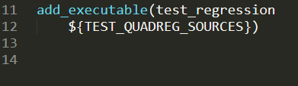
What is a target?
A target is anything that CMake can build:
Executable
Static library
Shared library
Object library
Custom target (we’ll talk about these in session 4)
The entire purpose of a build system, its reason for existence, is to create targets.

Slide 5
CMake build systems are structured around targets
All code files are compiled as part of one target or another
Dependencies are expressed in terms of targets
“Dependency” in CMake means “build X before Y”
Dependencies are automatically created between an executable and its libraries
myprogram
libmylibrary.a

Slide 6
Executable targets
Created by add_executable()
Create programs that can be run (.exe on Windows, no suffix on Mac)
On microcontrollers, e.g. MBed, these create images that can be programmed to the chip

Slide 7
Static library targets
Created by add_library(STATIC)
Create static libraries of code that can be linked into executables (.lib on Windows MSVC, .a elsewhere)

Slide 8
Object library targets
Created by add_library(OBJECT)
Create object libraries: code compiled into .o files but not combined into a single library
Function very similar to STATIC libraries, used in certain specific cases
Most common use: improving performance by only building certain code files once that are needed for multiple targets
You likely won’t need to use these except for very complicated build systems!

Slide 9
Properties can be used to configure the build further
What you can’t accomplish through functions in CMake, you accomplish through properties.
Properties determine the specific details of how CMake builds a target, such as compile flags and link libraries
Properties can be set on a number of different levels:
Global (affects the entire project)
Directory (affects the current directory and all subdirectories)
Target (affects a specific target)
Source (affects a specific source file in all targets it’s present in)
List of all properties (you will use this doc page a LOT): https://cmake.org/cmake/help/latest/manual/cmake-properties.7.html

Slide 10
Properties can be used to add compile flags.
Property | Scope | Function
INCLUDE_DIRECTORIES | Directory, Target, Source (since CMake 3.11) | List of directories to add to the include path
COMPILE_DEFINITIONS | Directory, Target, Source | List of preprocessor macros to define when compiling the code
COMPILE_OPTIONS | Directory, Target, Source (since CMake 3.11) | List of compiler flags to use when compiling the code.
POSITION_INDEPENDENT_CODE | Target | Controls whether the code will be built as position independent, which is required when compiling shared libraries.
Notes:
<number>

Slide 11
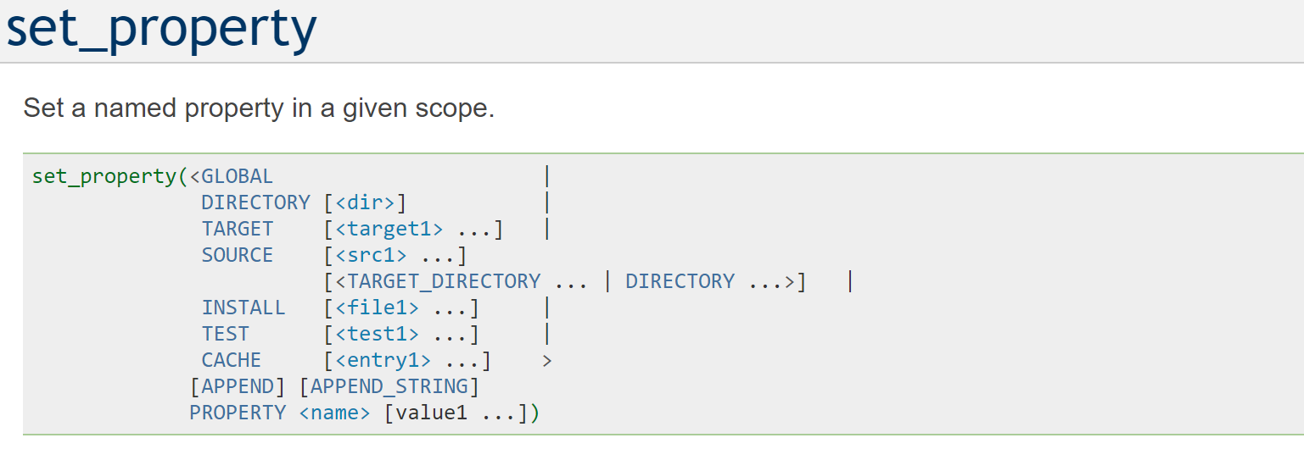
Setting properties the standard way
CMake has a number of different functions to set properties, but some of them have hidden gotchas!
e.g. not accepting a list as a property value
Instead, use the one function that can do it all:

Slide 12
Properties can also be used to configure targets.
Property | Scope | Function
OUTPUT_NAME | Target | Name of the library or executable file that is built. Used when you need a different name than its CMake target.
INSTALL_RPATH | Target | List of directories that will be searched for shared libraries when the program runs.
SOURCES | Target | Used to view or change the source files configured for a target.
LINK_LIBRARIES | Target | List of other libraries (targets or file paths) that the target should be linked to.
Notes:
OUTPUT_NAME is very useful if you want to build both an executable foo and a library libfoo. These would both have the same target name (foo), so CMake won’t allow that. What you can do is make the second target “libfoo”, then use OUTPUT_NAME to change it to just “foo”.
<number>

Slide 13
How to link targets
Libraries can be linked to a target using: target_link_libraries(<target name> <library targets…>)
This allows the target to reference code stored in the given libraries.
Link dependencies are multi-level: if you link libA to libB, and libB to libC, then CMake will automatically link libA to libC as well.
Linking will also pull in the interface options of the libraries being linked. Let’s discuss what that means.
Notes:
Linking is a word that gets thrown around a lot in these slides. At its core, it means that when code is compiled into the final product, code from the link libraries will be considered as well as code from the main target. This allows the main target to reference code stored in the given libraries.
Libraries can also have their own library dependencies, these are considered at every level. The final target will be linked with every dependency of every library.
<number>

Slide 14
Interface properties are used to carry dependencies between targets.
Many target properties come in two types: a private version (e.g. COMPILE_DEFINITIONS) and an interface version (e.g. INTERFACE_COMPILE_DEFINITIONS)
The private version affects the target it is set on
The interface version affects every other target that links to this target.

Slide 15
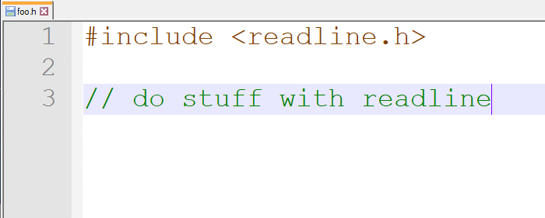
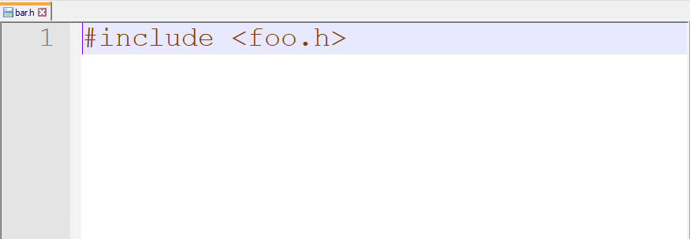
Why are interface properties useful?
bar.h (in another target) includes foo.h
foo.h requires the flag
-I/usr/include/readline
to compile.
Solution:
set_property(TARGET foo PROPERTY INTERFACE_INCLUDE_DIRECTORIES /usr/include/readline)
Notes:
If we didn’t have interface properties, then every target that links to foo would also need to add this flag. That’s really annoying to remember!
So, we can use interface properties to convey that this include directory needs to be added to all consumers of foo.
<number>

Slide 16
Exercise 1: Adding a Static Library
Now we will apply what we’ve learned!
We will take the project from session 1 and convert it into contain a C++ library.
We will do a static library for now (shared libraries will be covered in session 3), and it will contain the quad reg code.
It will also set interface properties to make using the code easier.

Slide 17
Exercise 1 Setup
Open a terminal in CMakeTraining/exercises/session2
Run these commands to set up the cmake project:
mkdir build
cd build
cmake ..

Slide 18
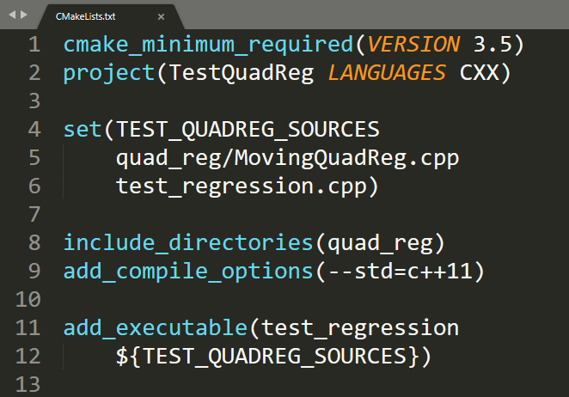
Exercise 1 Background
You’ll recall our top-level CMakeLists from last time.
We now want to separate MovingQuadReg into its own library.
There’s another annoyance: having to include the quad_reg directory in the top-level CMakeLists.
We’re going to fix that too.
Notes:
<number>

Slide 19
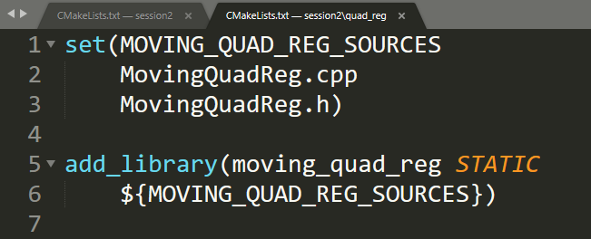
Creating the Library
Create a new CMakeLists.txt in the quad_reg folder.
Add a source list and create the library.
Notes:
Note: it’s important to add the header files to the source list if you are using an IDE such as CLion. Otherwise, CMake ignores them.
<number>

Slide 20
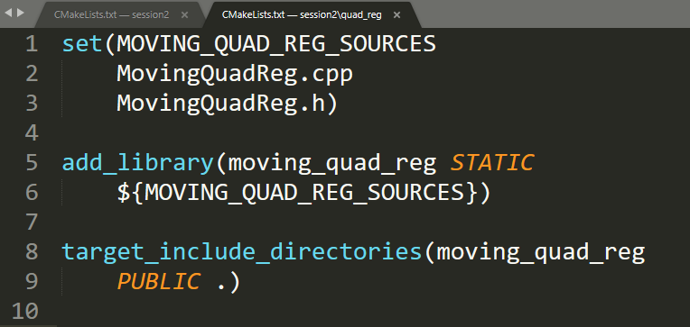
Interface Include Directories
Now we’re going to take our first step toward fixing the include file problem.
Start by adding the call to target_include_directories().
This function is shorthand for setting the INCLUDE_DIRECTORIES target property.
With the PUBLIC keyword it sets both the interface and private versions of the property.
Note: target_compile_options() and target_compile_definitions() also exist and have the same behavior for their respective properties.
Notes:
Note: it’s important to add the header files to the source list if you are using an IDE such as CLion. Otherwise, CMake ignores them.
<number>

Slide 21
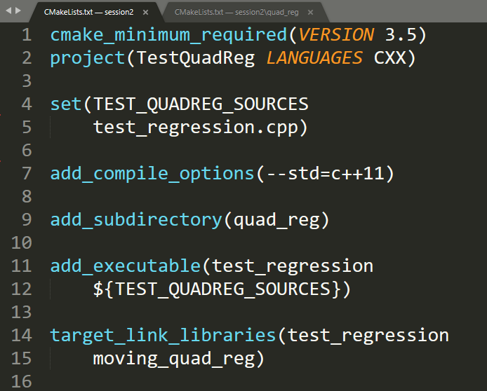
Using the library
Back to the top-level CMakeLists.txt.
Remove MovingQuadReg from the source list.
Add the add_subdirectory() call. This calls the CMakeLists.txt that we created in quad_reg.
Remove the include_directories() call – it’s not needed any more.
Add the target_link_libraries() call. This links our executable to the library that we just created.
Notes:
<number>

Slide 22
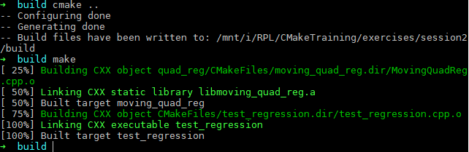
Exercise 1: Results
Run your code:
cmake ..
make
You should see things build just like before, only now the quadratic regression code will get built into a library first.

Slide 23
Part 2
Build Types and Compile Flags

Slide 24
The Weirdness that is Cache Variables
Like all build systems, CMake provides a way for you to pass command line options that affect the build system’s behavior
It’s also desirable to have a way to store the results of different tests so the cmake script runs faster when you run it subsequent times
For CMake, both of these are achieved through the same mechanism: cache variables
Cache variables are special variables that keep their values between invocations of CMake

Slide 25
Creating Cache Variables
Cache variables are created using an alternate signature for set().
Signature: set(<variable> <value>... CACHE <type> <docstring> [FORCE])
CACHE keyword argument specifies cache signature
Type specifies the type of data that will be stored in the variable.
Possible values: BOOL, FILEPATH, PATH, STRING, INTERNAL
docstring is the comment that will be attached to the variable in the cache.
If FORCE is given, the variable’s value will be overwritten. Otherwise it will not be modified if it already exists
Why is this?

Slide 26
Command Line Options
Cache variables can also be set on the command line using –DMY_CACHE_VAR=<value>
Intention is for set(CACHE) to be used to initialize an option with a default value, and then the user can override it on the command line
However, sometimes scripts need to store data even though it isn’t a settable option. This is what the INTERNAL type, which hides the variable from the user, is for

Slide 27
Viewing Cache Variables
Cache variables can be viewed and edited by:
Editing CMakeCache.txt
Using the ccmake tool
Using the cmake-gui tool
The intention was for these to provide a user-friendly interface for configuring CMake projects
However, 95% of users don’t know these exist, so developers don’t usually spend time making them clean and usable, so people rarely use them
Bit of a chicken-and-egg problem…

Slide 28
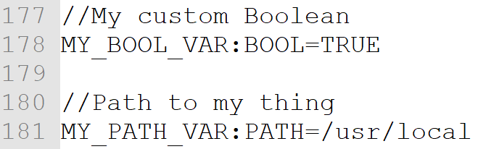
Cache Variable Example: CMakeCache.txt
<snip>

Slide 29
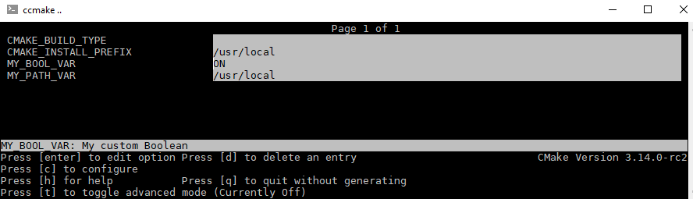
Cache Variable Example: ccmake

Slide 30
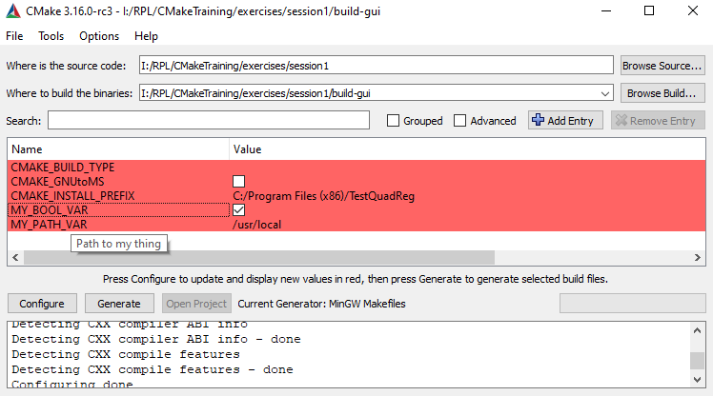
Cache Variable Example: cmake-gui

Slide 31
Cache Variable Overriding: A Cheat Sheet
This is one of the most confusing things in CMake by a large margin. Even I still mess it up.
If a _____ is defined, and you set a ____ with the same name, then…
local variable | local variable | The local variable’s value is changed.
cache variable | cache variable (without FORCE) | The cache variable’s original value is not changed
cache variable | cache variable (with FORCE) | The cache variable’s original value is overwritten
cache variable | local variable | The cache variable is shadowed while the local variable is in scope
local variable | cache variable | If the cache variable was already in the cache, then the cache variable stays out of scope. However, if the cache variable did not exist, the local variable is deleted and the new cache variable is put into scope

Slide 32
Cache Variables Practice 1
What will it print?
-- Stuff will be installed to: /usr

Slide 33
Cache Variables Practice 2
What will it print?
-- Stuff will be installed to: /opt

Slide 34
Cache Variables Practice 3
What will it print?
The first time CMake is run:
-- Stuff will be installed to: /opt
Subsequent runs:
-- Stuff will be installed to: /usr

Slide 35
Build configurations are used to adapt your build for different situations.
Most build systems have the concept of Debug vs Release configurations.
Debug configuration: Optimization turned down to a low level or disabled, debug information generated.
Release configuration: Optimization at full, no debug information
In CMake, this is achieved through the CMAKE_BUILD_TYPE cache variable.
This variable, by default, has four standard build types: Debug, Release, RelWithDebInfo, and MinSizeRel.
Notes:
Most build systems have the concept of Debug vs Release configurations. This is used to configure your build for different situations that pop up commonly when programming.
Debug configuration: Optimization turned down to a low level or disabled, debug information generated.
This lets you debug your code, BUT it makes your programs run slower and take up significantly more disk space (debug information is THICC)
Release configuration: Optimization at full, no debug information
In CMake, this is achieved through the CMAKE_BUILD_TYPE cache variable.
Initialize it like this: set(CMAKE_BUILD_TYPE Release CACHE STRING "Type of build, options are: Debug, Release")
<number>

Slide 36
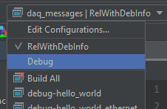
Using CMAKE_BUILD_TYPE
CMAKE_BUILD_TYPE is often set on the command line when building, e.g. -DCMAKE_BUILD_TYPE=Release. It is also set through the menu in IDEs.
CMAKE_BUILD_TYPE‘s main purpose is to control which compile flags are used.
You can also use generator expressions to make it control other things, such as using a different version of a system library in debug vs release mode.
Notes:
Not talked about on this slide: multi-configuration generators. These generators generate buildfiles for all build types at the same time. You can then switch between configurations without running cmake. These generators ignore the CMAKE_BUILD_TYPE variable.
<number>

Slide 37
Compile flags come from many different sources.
Directory properties:
COMPILE_OPTIONS
INCLUDE_DIRECTORIES
COMPILE_DEFINITIONS
Build type global compile flags (CMAKE_CXX_FLAGS_DEBUG)
Global compile flags (CMAKE_CXX_FLAGS)
Target properties:
COMPILE_OPTIONS
INCLUDE_DIRECTORIES
COMPILE_DEFINITIONS
(including interface properties from libraries that this target links to)
Compile flags used on a specific C++ source file
Source file properties:
COMPILE_OPTIONS
INCLUDE_DIRECTORIES
COMPILE_DEFINITIONS
Notes:
We’ve talked about all these properties, so everyone understands how that works, right?
Now we will talk about the global flags.
<number>

Slide 38
Global compile flags
CMake reads the global flags for each language from the cache variable “CMAKE_<language>_FLAGS”.
This is “old”, but not “legacy” – it’s so baked in to the language that there is no way they will ever change it.
As an old-style variable, it is a space-separated string, NOT a list.
CMAKE_<language>_FLAGS is vital for ONE specific situation: when certain flags are required to make your compiler work.
Example: when compiling for embedded ARM, you must pass –mcpu=<your CPU>.
This is because CMAKE_<language>_FLAGS is used in CMake’s testing of the compiler itself, and you need to make sure this testing goes smoothly.
Notes:
It is a really unfortunate situation that users are conditioned to set this variable to add extra compile flags, because it can cause problems in some situations by blowing away the preset compile flags.
<number>

Slide 39
How to live with CMAKE_<language>_FLAGS
Option one: ignore it completely.
Instead, apply all flags through directory and target properties.
This is nice because users can set it to add flags without doing any harm
Option two: initialize it by setting CMAKE_<language>_FLAGS_INIT before the project() call.
The value will be copied from this variable when your project is configured.
This is required if you need specific flags to make your compiler work properly
However, you must tell your users to not set the variable manually, and give them some other option that adds compile flags if needed.

Slide 40
Build type global compile flags
CMake also reads the flags for each configuration from the variable “CMAKE_<language>_FLAGS_<configuration>” (e.g. CMAKE_C_FLAGS_DEBUG).
These are initialized to sensible defaults by CMake.
e.g. for Release, CMAKE_C_FLAGS_RELEASE is initialized to “-O3 –DNDEBUG”
You can set these to your own values after the project() command if you want to change them.
Notes:
It’s best to set these as local variables to shadow whatever the cache variable is defined to.
<number>

Slide 41
Exercise 2: Adding Compile Flags
This short exercise will apply some of what we just learned.
We’re going to add multiple configuration types to our build system

Slide 42
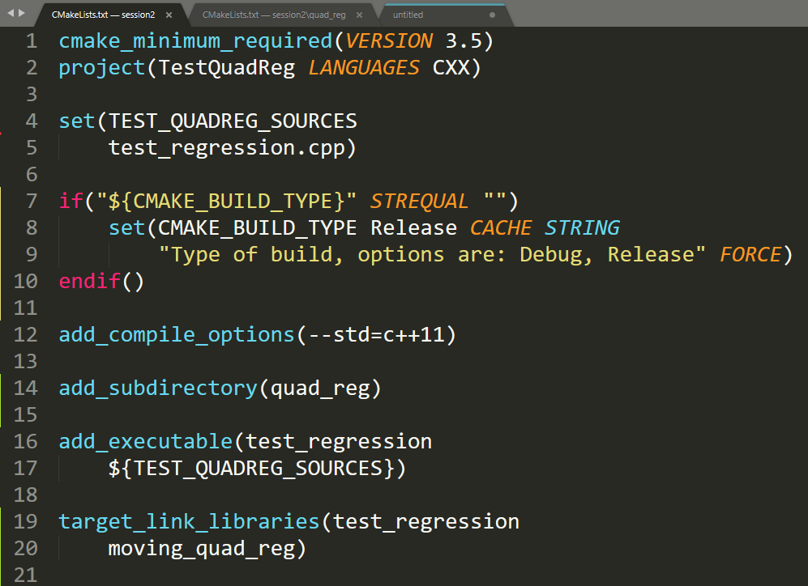
Adding a build type
First we need to initialize the build type.
It defaults to an empty cache variable on the first run, so we need to define it.
This code defaults it to Release, but you can use whatever works best for your project.
NOTE: If supporting multi-configuration generators such as Visual Studio, a more complicated version of this code is needed. See here for details.

Slide 43
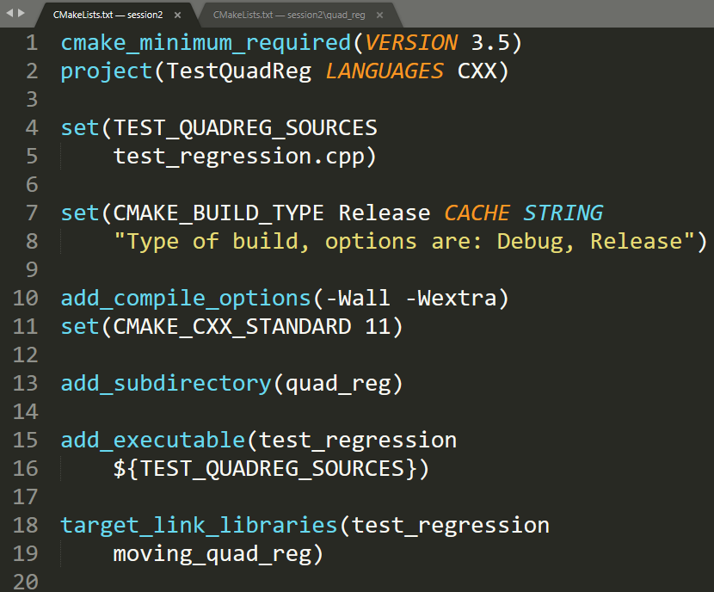
Default compile options
Now we’ll set up standard compile flags to enable warnings. Note that we are setting directory properties and ignoring CMAKE_CXX_FLAGS completely.
We can also replace the --std=c++11 flag with something more portable. Setting CMAKE_CXX_STANDARD will cause CMake to automatically apply the correct flag for the current compiler.
Notes:
Note that different compilers can often use totally different flags. In session 4 I’ll teach you how to handle this and apply different flags depending on the compiler and its version.
<number>

Slide 44
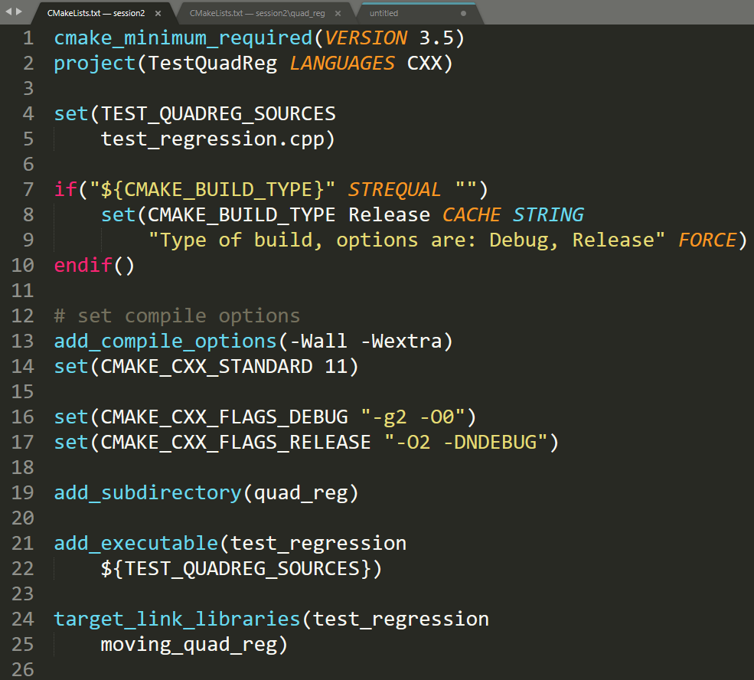
Build type compile flags.
Now we will set the build type compile flags.
These are sensible defaults.
The Debug flags allow debugging and disable optimization
The Release flags enable optimization and disable asserts (that’s what -DNDEBUG does).

Slide 45
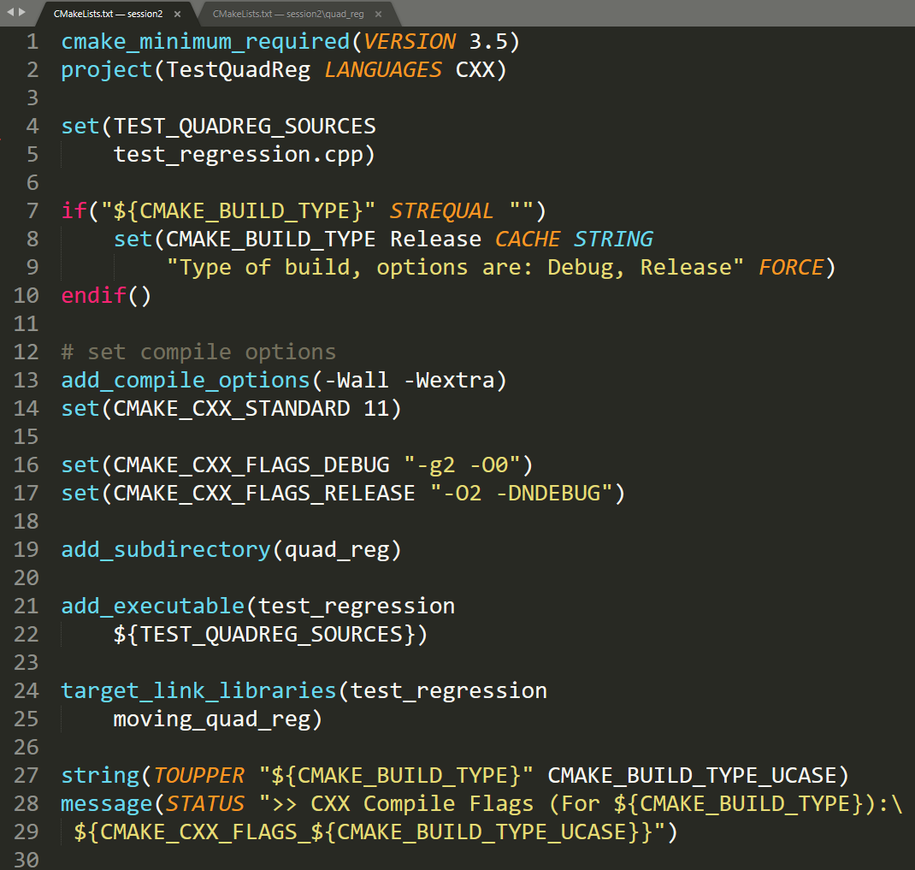
Printing Compile Flags
But with multiple configurations in the mix, how are users to know what the current compile flags are?
For this, we will print a simple build report showing the current build type compile flags.
We can get these by using a nested variable evaluation with CMAKE_BUILD_TYPE – but we have to convert it to uppercase first.
Then we can print it out using CMake’s message(STATUS) command.
Notes:
With a bit of work, you can expand this report to show other useful info, like libraries being linked to and the top-level DIRECTORY PROPERTY COMPILE_FLAGS.
<number>

Slide 46
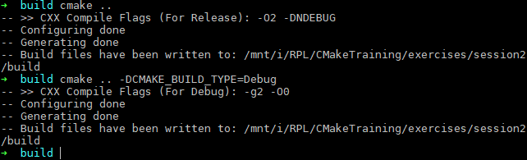
Exercise 2: Results
First run CMake leaving the build type at its default: cmake ..
Now change the build type: cmake .. –DCMAKE_BUILD_TYPE=Debug
The compile flags will change like magic!

Slide 47
Session 2 Review
Targets
Properties
Linking and interface properties
Cache variables
Build type
Global compile flags
Notes:
Today we discussed a number of key CMake concepts.
This should give you enough groundwork to make basic projects on your own. However, there are still a number of advanced concepts left, especially for desktop build systems.
First and foremost is shared libraries, which we’ll talk about next time. See you then!
<number>

